Slide 1

Model-BASED Design (MBD)
Part1: MBD Engineer vs. Embedded Engineer – What's the Difference?

Slide 2
MBD Engineer vs. Embedded Engineer: Which Path Suits You? 🤔
MBD
Embedded

Slide 3
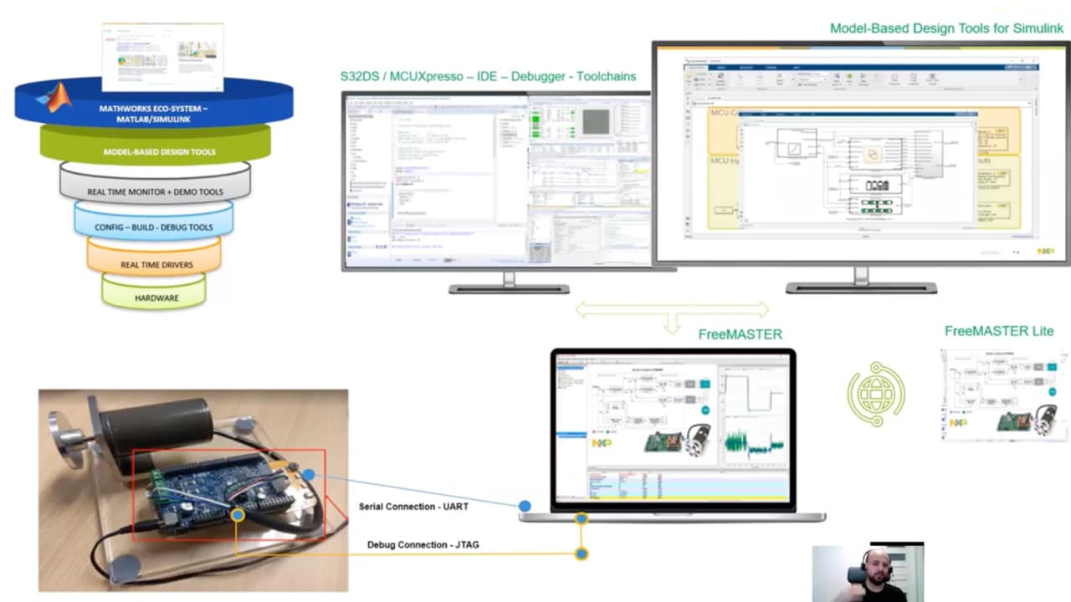
🔹 MBD Engineer:
🔸 Works at a higher level of abstraction, focusing on designing, simulating, and verifying systems using tools like MATLAB/Simulink. 🔸 Uses block diagrams and state machines to model control algorithms before implementation. 🔸 Relies on automatic code generation (via tools like Embedded Coder) to translate models into embedded C code. 🔸 Plays a key role in rapid prototyping, Hardware-in-the-Loop (HIL), and Software-in-the-Loop (SIL) testing.

Slide 4
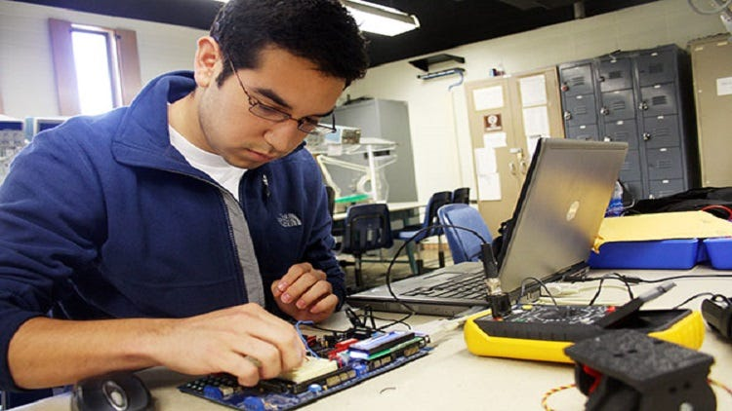
🔹 Embedded Engineer:
🔸 Works closer to hardware, writing optimized C/C++ code for microcontrollers and embedded systems. 🔸 Focuses on low-level programming, firmware development, and hardware interfacing. 🔸 Deals with real-time constraints, memory management, and power optimization. 🔸 Implements and debugs software directly on hardware using IDE, debuggers, and logic analyzers.

Slide 5

⚡️ So, Which Role is Right for You?
Love math, simulations, and high-level design?
Go for MBD!
Enjoy low-level coding, hardware, and real-time systems? Embedded Engineering is for you!
👉 Which path are you more interested in? Let’s discuss in the comments! 💬

Slide 6

Model-BASED Design (MBD)
PART II: MBD Process & V-Model – The Secret to Robust System Design

Slide 7
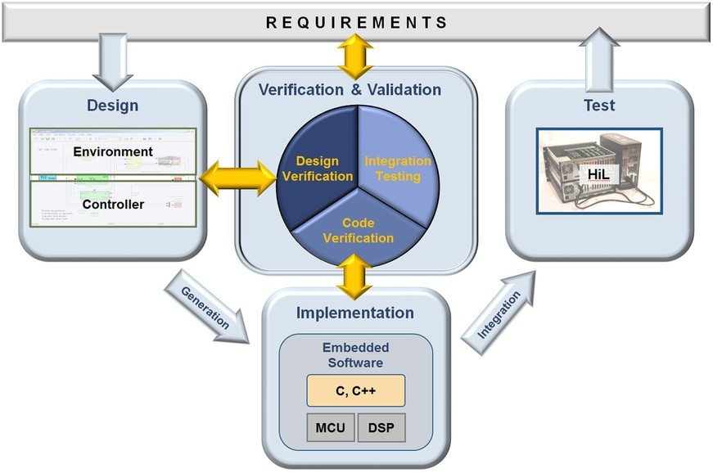
🚀 Ever Wondered How Complex Systems Are Designed with Minimal Errors?
🔎 The Model-Based Design (MBD) Process follows a structured approach to develop, simulate, test, and deploy control systems, ensuring efficiency and reliability.
One of the most powerful methodologies in MBD is the V-Model. But why is it so important? 🤔

Slide 8
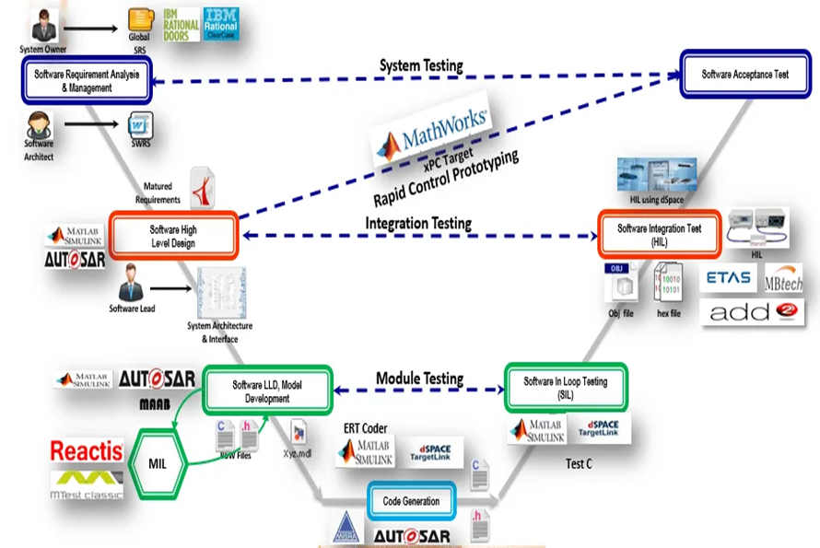
🔹 The V-Model: A Blueprint for Success
🔻 Left Side – System Design & Decomposition 1️⃣ Requirements Definition (System-level specs & constraints) 2️⃣ System Design (Defining high-level architecture) 3️⃣ Modeling & Simulation (Building Simulink models) 4️⃣ Code Generation & Integration (Automatic Embedded C code from models)

Slide 9

🔹 The V-Model: A Blueprint for Success
🔺 Right Side – Testing & Validation 5️⃣ Unit Testing (Verifying small components) 6️⃣ Integration Testing (Ensuring modules work together) 7️⃣ Hardware-in-the-Loop (HIL) Testing (Validating on real hardware) 8️⃣ System Validation (Final validation before deployment)

Slide 10

📢 Why Does MBD + V-Model Matter?
Reduces development time and cost
Catches design flaws early through simulation
Ensures smooth integration between software & hardware
Enhances system reliability & safety

Slide 11
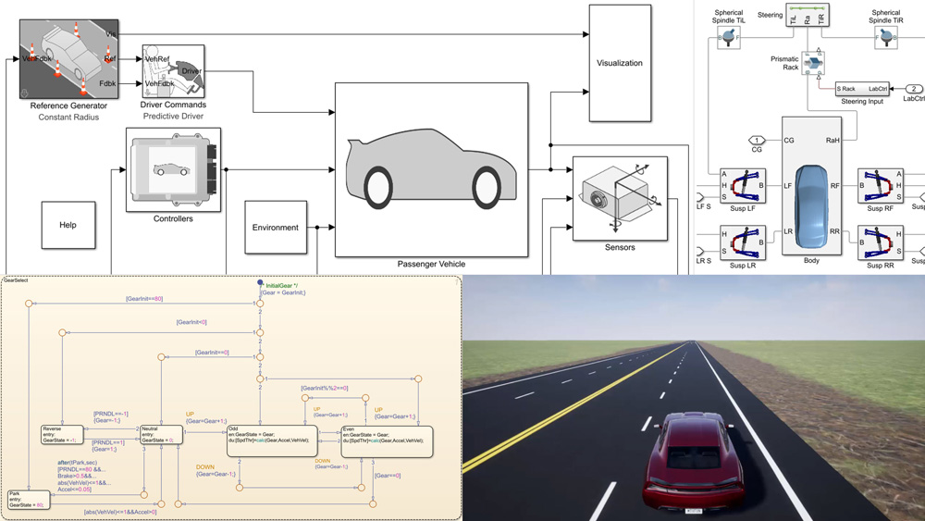
Model-BASED Design (MBD)
PART III: Acceleration Pedal Position Modeling and Testing

Slide 12
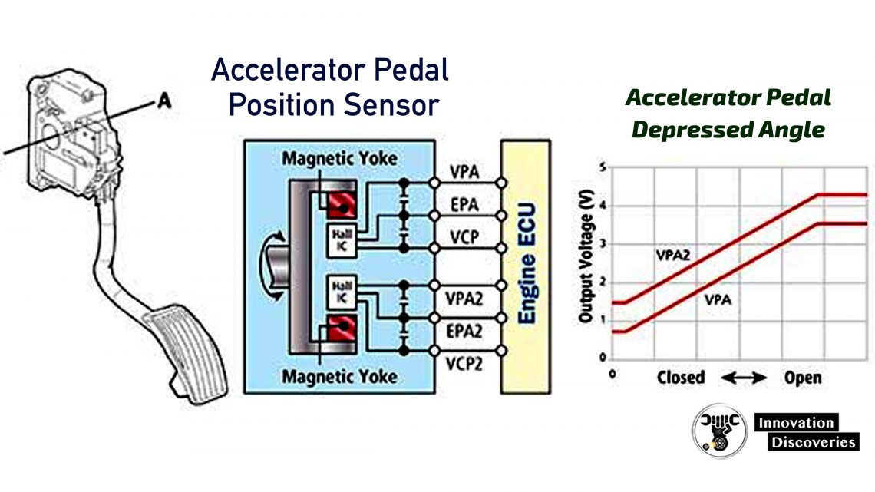
🔧 Acceleration Pedal Position Modeling The acceleration pedal position is usually measured using two redundant sensors to enhance safety and reliability. The sensors provide independent signals to the Electronic Control Unit (ECU) to detect any discrepancies and ensure fail-safe operation.
🛠️ Modeling Approach:
Sensor Modeling: Develop mathematical models for both sensors that simulate real-world behavior.
Signal Processing: Implement filtering to minimize noise and enhance accuracy.
Fault Detection Logic: Create control logic that:
Compares signals from both sensors.
Detects inconsistencies and flags potential faults.
Identifies which sensor is malfunctioning based on signal deviation and plausibility checks.

Slide 13
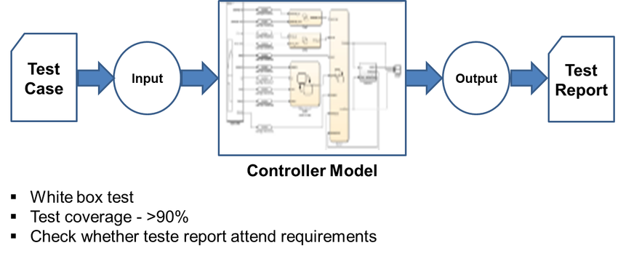
🧪 Model-in-the-Loop (MIL) Testing:
Model-based testing is crucial for verifying the accuracy and robustness of the control logic.
✅ MIL Test Steps:
Simulate Normal Operation: Ensure both sensors deliver consistent signals.
Inject Faults: Introduce discrepancies like stuck-at values or noisy signals to simulate sensor failure.
Verify Fault Detection Logic: Check that the system accurately identifies faulty sensors and initiates safety measures.

Slide 14
🔧 Acceleration Pedal Position Modeling

Slide 15
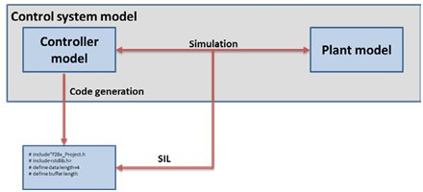
💻 Software-in-the-Loop (SIL) Testing:
After validating the model, it’s time to test the generated code.
✅ SIL Test Steps:
Integrate the Auto-Generated Code into a virtual ECU environment.
Re-run Test Cases from MIL to ensure the behavior is consistent.
Monitor Real-Time Performance: Check the system's ability to detect faults without compromising speed.

Slide 16
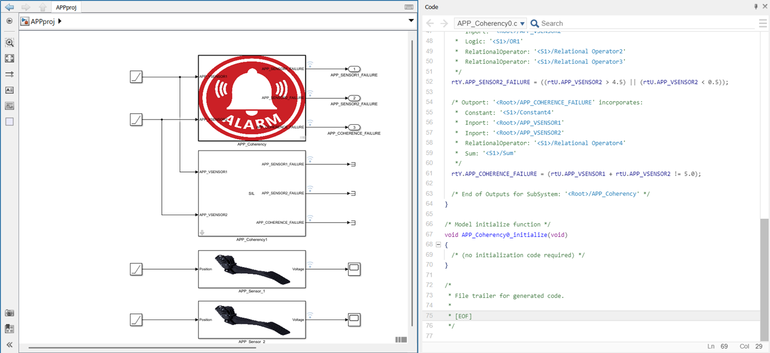
🔧 Acceleration Pedal Position Modeling
APP_Coherency0.c

Slide 17
🔧 Acceleration Pedal Position Modeling
/*
* File: APP_Coherency0.c
*
* Code generated for Simulink model 'APP_Coherency0'.
*
* Model version : 1.7
* Simulink Coder version : 9.5 (R2021a) 14-Nov-2020
* C/C++ source code generated on : Mon Mar 10 00:21:51 2025
*
* Target selection: ert.tlc
* Embedded hardware selection: Atmel->AVR
* Code generation objectives:
* 1. Execution efficiency
* 2. RAM efficiency
* Validation result: Not run
*/
#include "APP_Coherency0.h"
/* External inputs (root inport signals with default storage) */
ExtU rtU;
/* External outputs (root outports fed by signals with default storage) */
ExtY rtY;
/* Real-time model */
static RT_MODEL rtM_;
RT_MODEL *const rtM = &rtM_;
/* Model step function */
void APP_Coherency0_step(void)
{
/* Outputs for Atomic SubSystem: '<Root>/APP_Coherency' */
/* Outport: '<Root>/APP_SENSOR1_FAILURE' incorporates:
* Constant: '<S1>/Constant'
* Constant: '<S1>/Constant1'
* Inport: '<Root>/APP_VSENSOR1'
* Logic: '<S1>/OR'
* RelationalOperator: '<S1>/Relational Operator'
* RelationalOperator: '<S1>/Relational Operator1'
*/
rtY.APP_SENSOR1_FAILURE = ((rtU.APP_VSENSOR1 > 4.5) || (rtU.APP_VSENSOR1 < 0.5));
/* Outport: '<Root>/APP_SENSOR2_FAILURE' incorporates:
* Constant: '<S1>/Constant2'
* Constant: '<S1>/Constant3'
* Inport: '<Root>/APP_VSENSOR2'
* Logic: '<S1>/OR1'
* RelationalOperator: '<S1>/Relational Operator2'
* RelationalOperator: '<S1>/Relational Operator3'
*/
rtY.APP_SENSOR2_FAILURE = ((rtU.APP_VSENSOR2 > 4.5) || (rtU.APP_VSENSOR2 < 0.5));
/* Outport: '<Root>/APP_COHERENCE_FAILURE' incorporates:
* Constant: '<S1>/Constant4'
* Inport: '<Root>/APP_VSENSOR1'
* Inport: '<Root>/APP_VSENSOR2'
* RelationalOperator: '<S1>/Relational Operator4'
* Sum: '<S1>/Sum'
*/
rtY.APP_COHERENCE_FAILURE = (rtU.APP_VSENSOR1 + rtU.APP_VSENSOR2 != 5.0);
/* End of Outputs for SubSystem: '<Root>/APP_Coherency' */
}
/* Model initialize function */
void APP_Coherency0_initialize(void)
{
/* (no initialization code required) */
}
/*
* File trailer for generated code.
*
* [EOF]
*/

Slide 18

Thank YOU 😇🤗🌹 Project GitHub repo QR Code

